Slide 1


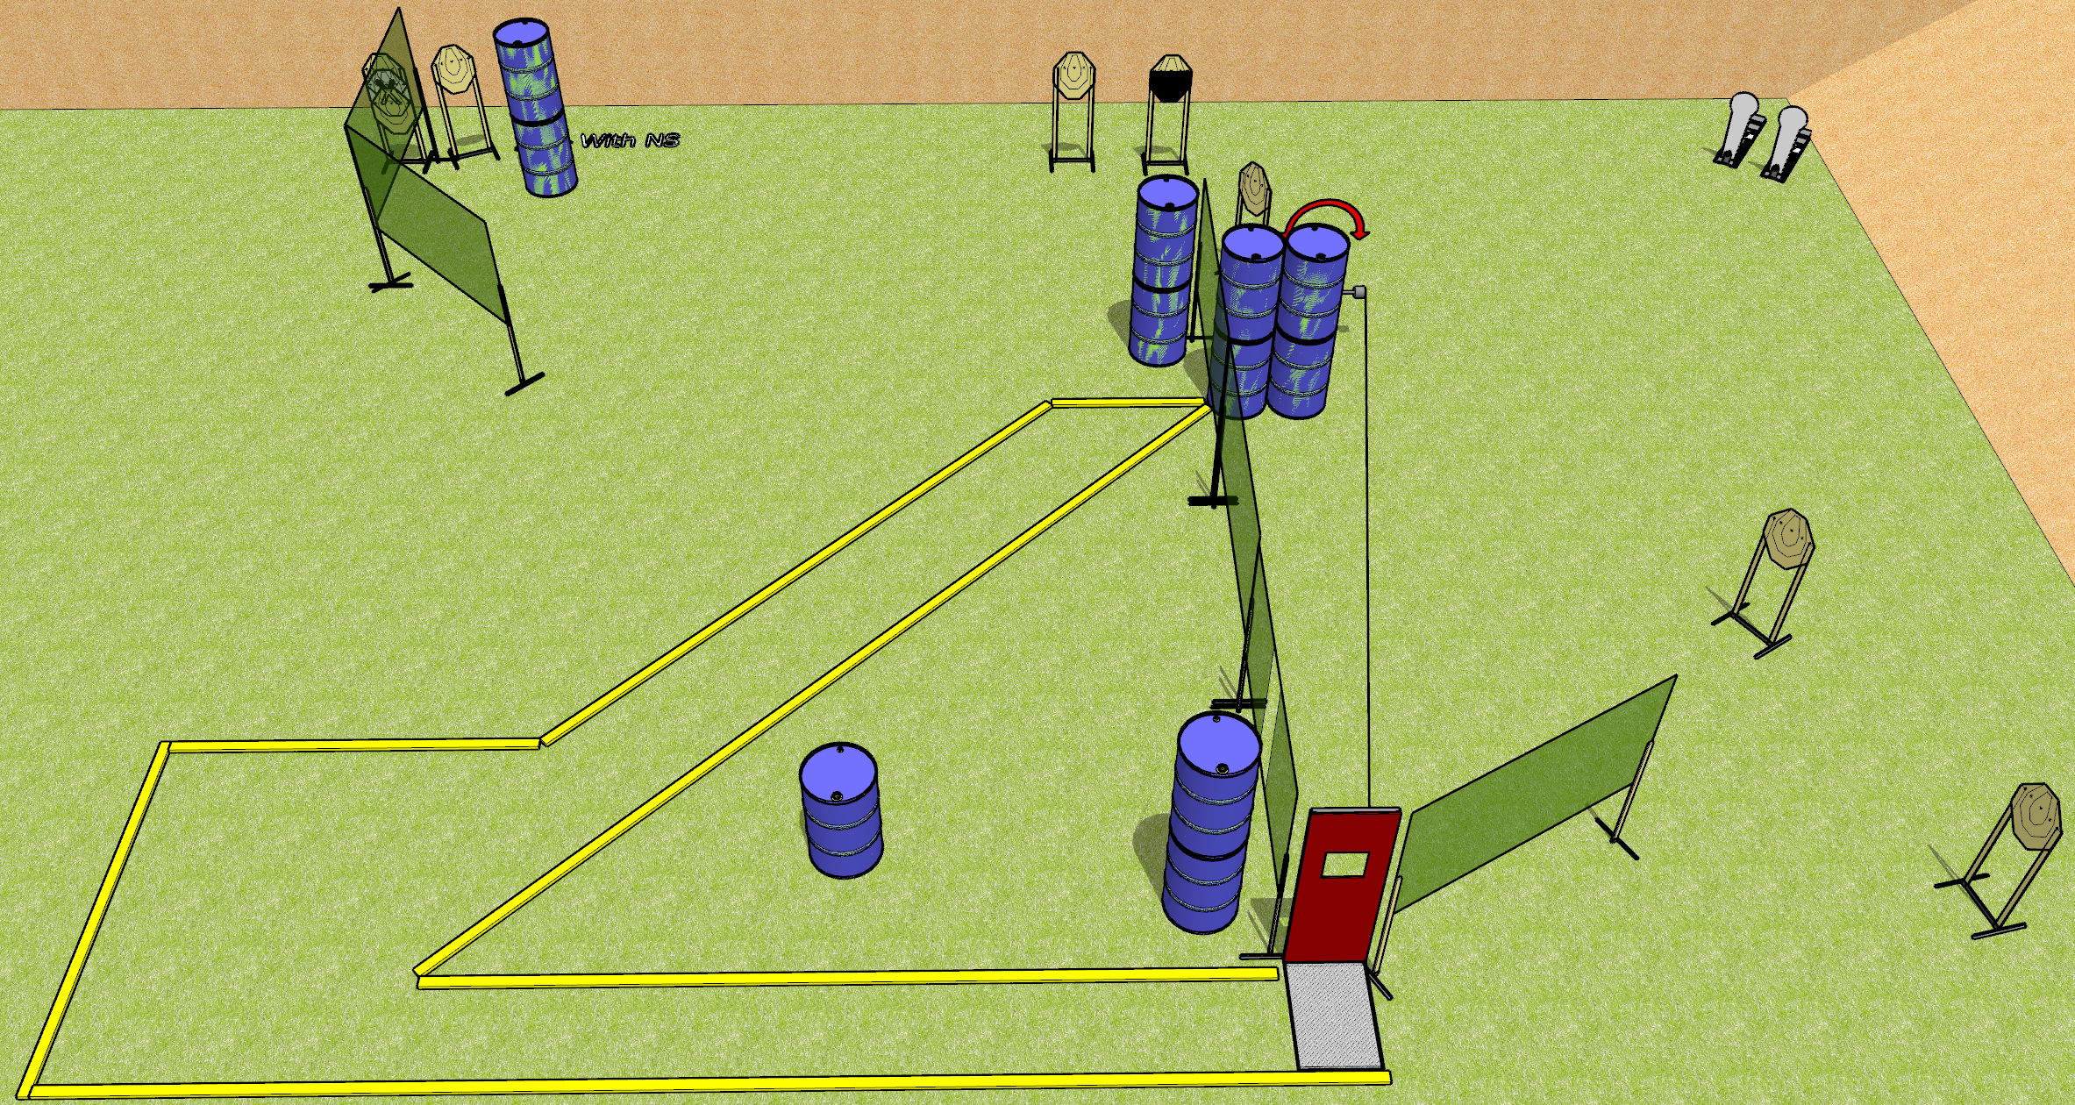
 | Dothan Gun Club – USPSA Match Middle of Nowhere Course Designer : Drew Coleman
Round Count 22 rounds 10 IPSC 2 colt poppers
Equipment List 10 wall feet Barricade with pull port Swinger + activator 1 50%

Slide 2
Middle of Nowhere
Written Stage Briefing
Middle of Nowhere is a 22 round, 110 point, Comstock course of fire. There are 10 IPSC targets and 2 colt poppers. The best 2 hits on paper wills core, and steel must fall to score. The start signal is audible.
The swinger is activated by the pull cord and remains visible at rest.
Handgun start position is inside the shooting area. Handgun is loaded on barrel.
PCC start position is inside the shooting area. Loaded carbine is placed on barrel.
On start signal, engage targets as they become available from within the shooting area.

